Slide 1

Introduction to Clinical Pharmacology Chapter 9 Antibacterial Drugs That Interfere With DNA/RNA Synthesis

Slide 2
Learning Objectives
Explain the uses, general drug actions, contraindications, precautions, interactions, and adverse reactions of antibacterial drugs that interfere with DNA/RNA synthesis.
Distinguish preadministration and ongoing assessment activities the nurse should perform on the client taking an antibacterial drug that interferes with DNA/RNA synthesis.
List nursing diagnoses particular to a client receiving an antibacterial drug that interferes with DNA/RNA synthesis.
Examine ways to promote an optimal response to therapy, how to manage adverse reactions, and important points to keep in mind when educating clients about the use of antibacterial drugs that interfere with DNA/RNA synthesis.

Slide 3
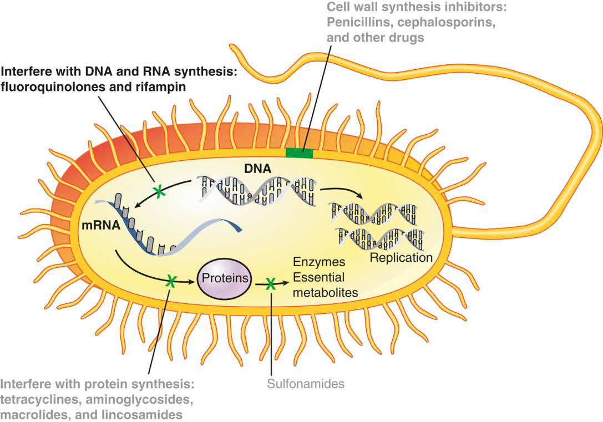
Antibiotics That Interfere With DNA/RNA Synthesis

Slide 4
Antibiotic Stewardship—Superinfections
Antibiotics can sometimes be overused
Superinfections happen when antibiotics disrupt normal flora causing a secondary infection or “superinfection”
C. diff.—one of the most common cause of antibiotic-related diarrheas in long-term care (LTC) facilities
Antibiotic Stewardship Program for Nursing Homes intends to reduce the inappropriate and unnecessary prescription of antibiotics in LTC
Types of superinfections
C. diff.
Candidiasis or moniliasis

Slide 5
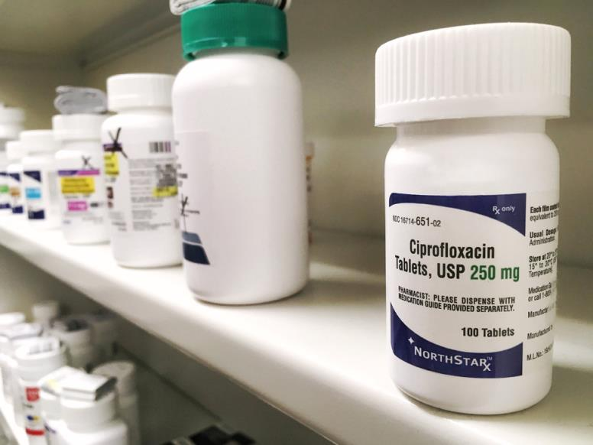
Fluoroquinolones—Actions
Bactericidal effect—interfere with the synthesis of bacterial enzymes which in turn prevent the making of bacterial DNA
Prevention of cell reproduction = bacterial cell death

Slide 6

Fluoroquinolones—Uses
Used to treat infections caused by gram-negative and gram-positive microorganisms:
Lower respiratory tract infections
Bone and joint infections
Urinary tract infections
Infections of the skin
Sexually transmitted infections
Ciprofloxacin and ofloxacin are ophthalmic forms for infections in the eyes

Slide 7

Fluoroquinolones—Adverse Reactions
Common Adverse Reactions:
Nausea
Diarrhea
Headache
Abdominal pain or discomfort
Dizziness
Photosensitivity
Serious Adverse Effects:
Aortic dissection or rupture
Hypersensitivity
Bacterial or fungal superinfections

Slide 8

Fluoroquinolones—Contraindications
Contraindicated in clients:
with a history of hypersensitivity
younger than 18 years
during pregnancy (pregnancy category C)
who cannot follow precautions regarding photosensitivity
Used cautiously in clients with:
Diabetes
Renal impairment
A history of seizures
Geriatric clients (greater risk of tendonitis and tendon rupture)
Dialysis

Slide 9
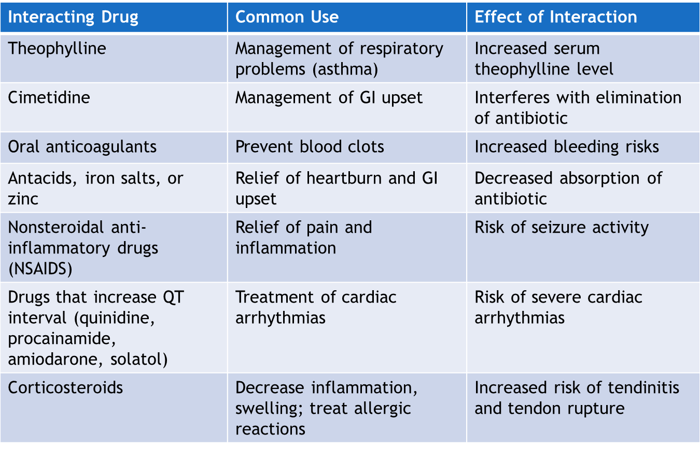
Fluroquinolones—Interactions

Slide 10

Nursing Process—Client Receiving a Fluoroquinolone or Miscellaneous Anti-Infective #1
Preadministration Assessment
Objective Data
Description of the external signs of infection (drainage, redness, changes in appearance of sputum, cough, and swelling)
Vital signs
Infection culture and sensitivity results
Renal and hepatic function tests, complete blood count, and urinalysis (if client has history of impaired function)

Slide 11
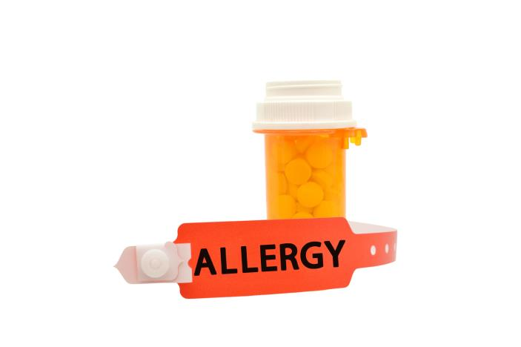
Nursing Process—Client Receiving a Fluoroquinolone or Miscellaneous Anti-Infective #2
Preadministration Assessment continued
Subjective Data
Client symptoms of infection including pain, malaise, and fatigue
Allergy history
History of heart, renal, or hepatic disease and any previous seizure activity

Slide 12

Pharmacology in Practice Exercise #1
The client is being treated with a fluoroquinolone for an infection. Tendon rupture occurs more frequently in the older adult when taking which of the following drugs with the fluoroquinolones?
Antianginal drugs
Corticosteroids
Oral antidiabetic drugs
Respiratory bronchodilators

Slide 13

Nursing Process—Client Receiving a Fluoroquinolone or Miscellaneous Anti-Infective #3
Ongoing Assessment
Take vital signs every 4 hours or as ordered
Notify the primary health care provider if there are changes in the vital signs or if signs and symptoms worsen
Compare current signs and symptoms of infection with baseline and/or previous assessments and record any specific findings

Slide 14
Nursing Process—Client Receiving a Fluoroquinolone or Miscellaneous Anti-Infective #4
Nursing Diagnoses
Risk for Impaired Comfort related to fever
Risk for Impaired Skin Integrity related to photosensitivity
Acute Pain related to tissue injury during drug therapy
Diarrhea related to superinfection secondary to antibiotic therapy or adverse drug reaction

Slide 15
Nursing Process—Client Receiving a Fluoroquinolone or Miscellaneous Anti-Infective #5
Planning
Expected client outcomes depend on the reason for administration of the antibiotic but may include:
Controlling the infectious process or prophylaxis of bacterial infection
Management of adverse drug effects
Confidence and understanding of the prescribed treatment regimen

Slide 16
Nursing Process—Client Receiving a Fluoroquinolone or Miscellaneous Anti-Infective #6
Implementation
Promoting an optimal response to therapy
Observe the client for adverse reactions during the first 48 hours of administration
Report any adverse reactions to the primary health care provider
Always listen to, evaluate, and report any complaints the client may have—could be an early sign of adverse drug reaction
Encourage clients to increase fluid intake

Slide 17

Nursing Process—Client Receiving a Fluoroquinolone or Miscellaneous Anti-Infective #7
Implementation
Promoting an optimal response to therapy continued
Norfloxacin given on empty stomach (1 hour before or 2 hours after meals)
Instruct client to swallow extended release or controlled release drugs whole without crushing, chewing, or breaking them
In a client taking an antacid, ciprofloxacin and moxifloxacin should be administered 2 to 4 hours before or 6 to 8 hours after the antacid

Slide 18
Pharmacology in Practice Exercise #2
The client was prescribed 320 mg of Gemifloxacin per day for 5 days. Today is Thursday. What will be the last day to take this prescription?

Slide 19

Nursing Process—Client Receiving a Fluoroquinolone or Miscellaneous Anti-Infective #8
Implementation—Monitoring and Managing Client Needs
Risk for Impaired Comfort related to fever
Monitor: temperature at frequent intervals
Elevated temperature (temp. over 101°F): notify the primary health care provider, check temperature, pulse, and respirations every hour until temperature returns to normal; administer antipyretic medication if prescribed

Slide 20

Nursing Process—Client Receiving a Fluoroquinolone or Miscellaneous Anti-Infective #9
Implementation—Monitoring and Managing Client Needs
Impaired Skin Integrity
Skin: more sensitive to sunlight when taking fluoroquinolones (photosensitivity)​
Sunscreens and cover-up clothing recommended

Slide 21
Nursing Process—Client Receiving a Fluoroquinolone or Miscellaneous Anti-Infective #10
Implementation—Monitoring and Managing Client Needs
Parenteral Administration
Acute Pain: Tissue Injury
Inspect needle site and area around needle for signs of extravasation of the IV fluid or tenderness, pain, and redness (signs of phlebitis or thrombophlebitis)
Check rate of infusion every 15 minutes
Assess the vein used for the IV infusion every 4 to 8 hours
In case of symptoms: restart the IV in another vein; report to primary health care provider

Slide 22
Nursing Process—Client Receiving a Fluoroquinolone or Miscellaneous Anti-Infective #11
Implementation—Monitoring and Managing Client Needs
Diarrhea
Observe for and report symptoms of bacterial or fungal superinfection—usually starts 4 to 10 days after initiation of treatment
Inspect stools for blood and mucus and report abnormalities to provider
Drug therapy may have to be discontinued to treat diarrhea, superinfection, or pseudomembranous colitis

Slide 23
Pharmacology in Practice Exercise #3
A superinfection can develop rapidly and is potentially serious. Identify how antibacterial drug therapy can lead to a superinfection. Arrange the following steps as they relate to developing a superinfection during anti-infective therapy.
Secondary infection is superimposed on the original infection
Uncontrolled growth of bacteria
Antibiotics disrupt the normal flora of the bowel
Client experiences cramping, diarrhea, and bleeding
Microorganisms produce toxins

Slide 24

Nursing Process—Client Receiving a Fluoroquinolone or Miscellaneous Anti-Infective #12
Implementation—Educating the Client and Family
Develop a teaching plan for the client and family to include:
Explain the adverse reactions of specific prescribed antibiotics
Advise about the signs and symptoms of potentially serious adverse effects

Slide 25
Nursing Process—Client Receiving a Fluoroquinolone or Miscellaneous Anti-Infective #13
Implementation—Educating the Client and Family continued
Develop a teaching plan for the client and family to include:
Monitoring for:
Fever
Rashes
Diarrhea
Burning sensation in the mouth or throat
Signs of fungal infection in mouth, groin, skin folds, and anogenital area

Slide 26
Nursing Process—Client Receiving a Fluoroquinolone or Miscellaneous Anti-Infective #14
Evaluation
Was the therapeutic effect achieved? Infection is controlled?
Were adverse reactions: identified, reported, and managed?
Client is comfortable and afebrile
Skin is intact and free of inflammation, irritation, infection, or ulcerations
Client reports no pain or injury
Client does not experience or is able to manager diarrhea
Did client and family express confidence and demonstrate understanding of drug regimen?

Slide 27

Turn and Talk—Case Study
A 54-year-old client is hospitalized for pyelonephritis. The physician orders ciprofloxacin 400 mg every 12 hours for 2 days and then ciprofloxacin 500 mg by mouth every 12 hours for 12 more days.
What preadministration assessments should be completed before starting the client on ciprofloxacin?
Ciprofloxacin is available in a 10-mg/mL vial. How many milliliters will the nurse need to prepare for one 400-mg dose?
What should the nurse tell the client about the ciprofloxacin before leaving the hospital?

